Slide 1
IS A HUMAN A KING OR A CHILD OF NATURE?

Slide 2
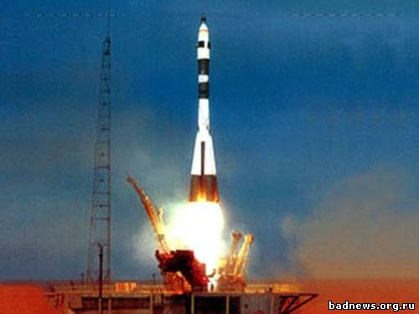
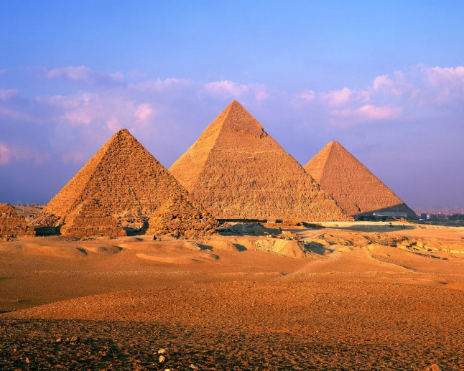
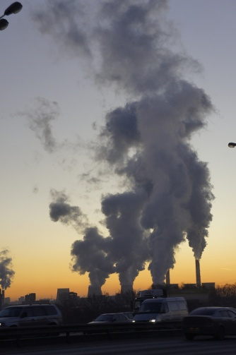
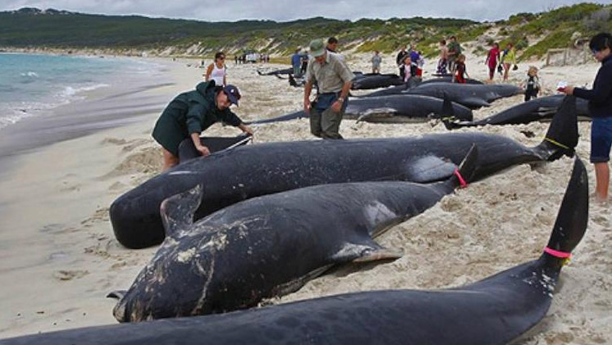
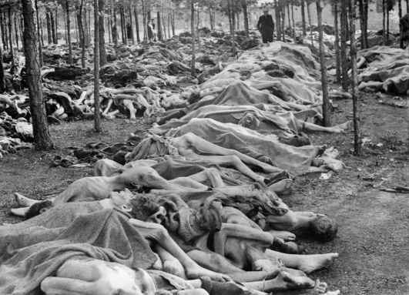
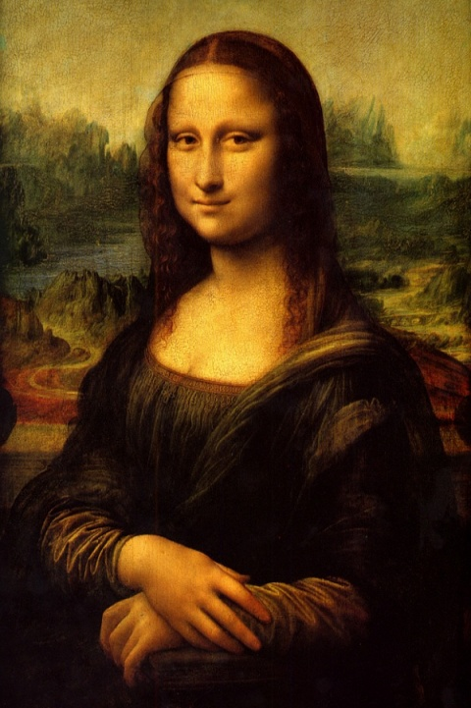
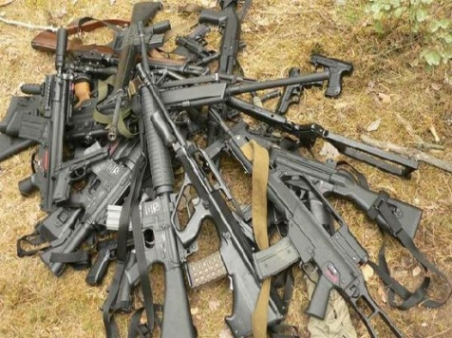
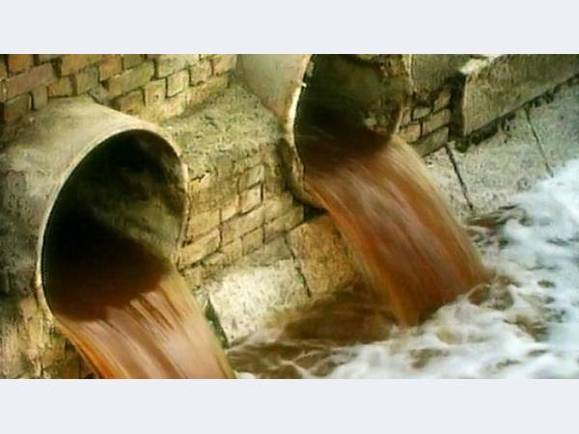
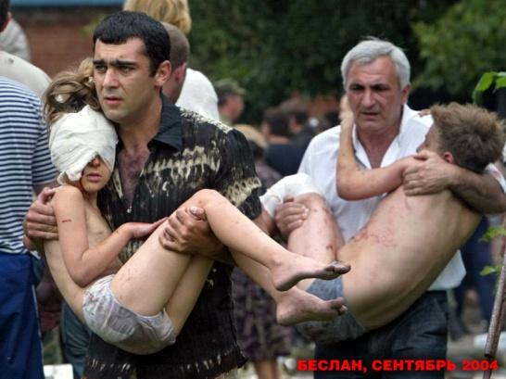
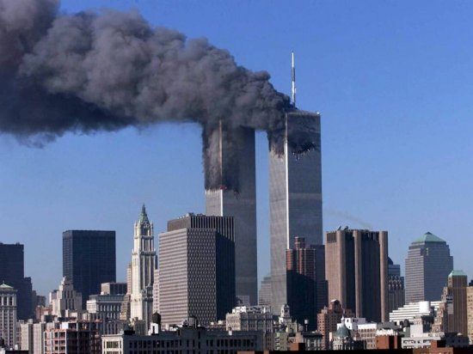
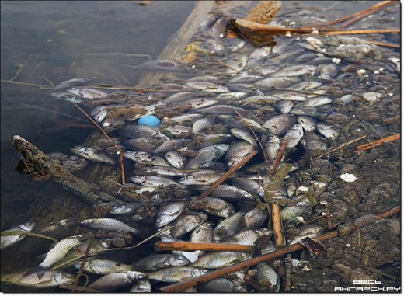
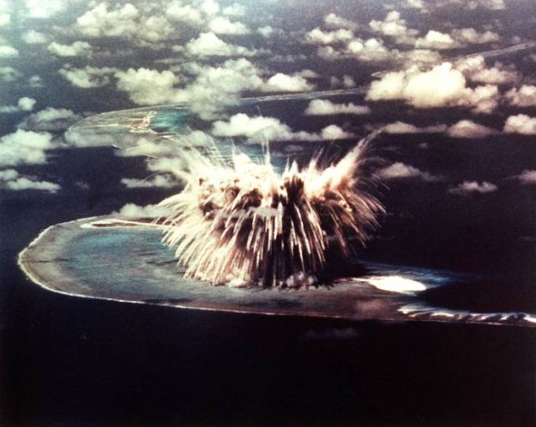
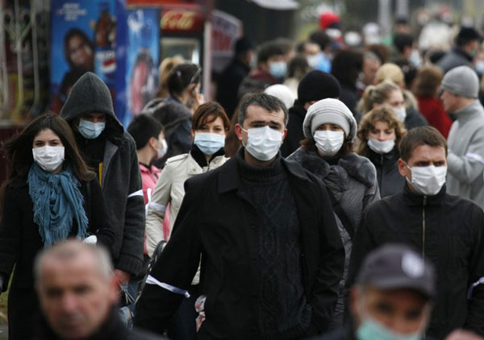
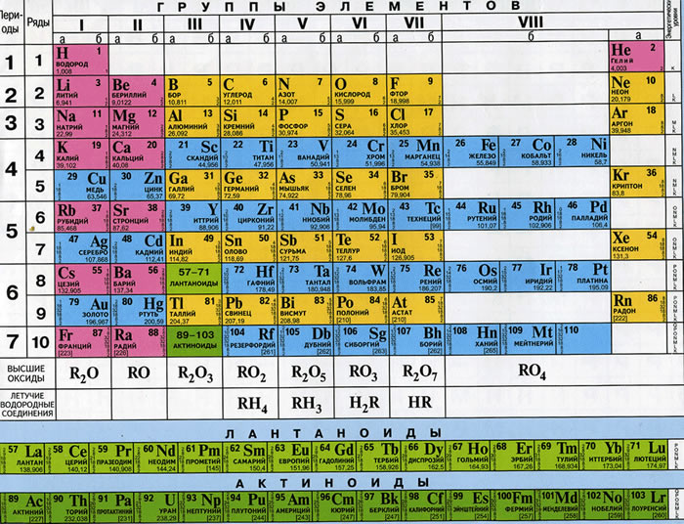
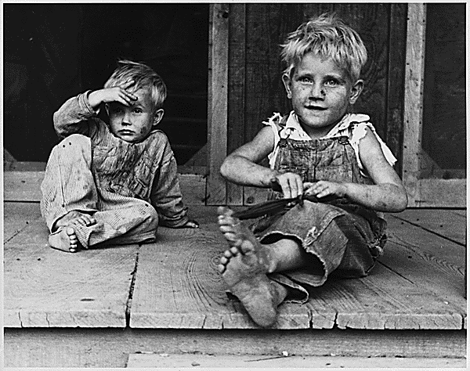

Slide 3
-What do you see? -what do you think about that? -What does it make you wonder? (speculate what you think about these photos. share and justify it with your partner and come to a consensus)
SEE-THINK-WONDER

Slide 4
Future
Will + Infinitive/Won’t + Infinitive/
I think ..., I hope ..., I'm sure ...
Example:
I think Labour will win the next election.
I hope you'll come and visit me.
I'm sure you'll pass your exams.
Complete the sentences
People ____ live on the Moon in 100 years.
The cars ____ fly.
People ____read the books.
The cars ____ use solar energy.

Slide 5
What will happen
with our planet in 100 years?
I think our planet...
People...
Children...
Students...
Animals...
Your ideas.

Slide 6
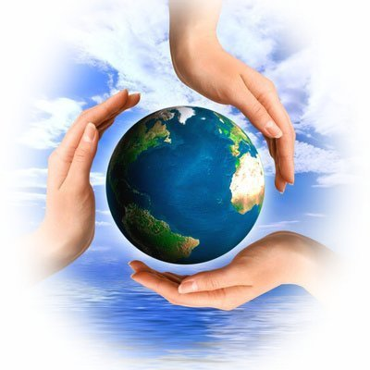
2013 year is declared the year of environmental culture and environmental protection

Slide 7
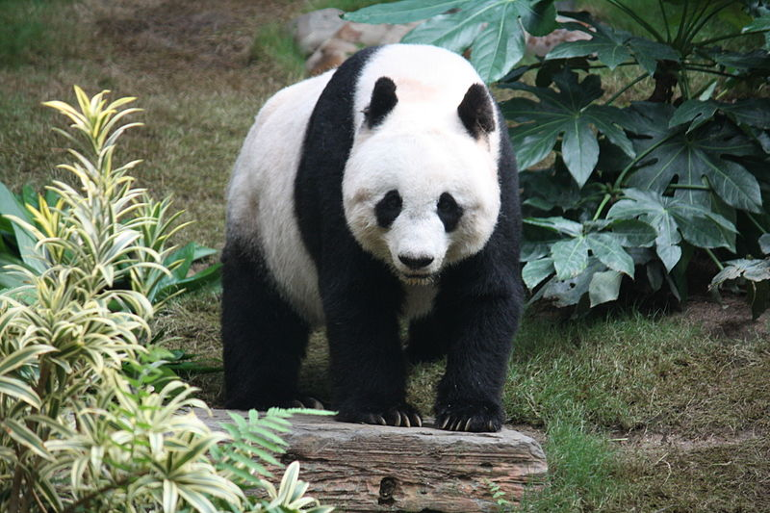
IFAW - International Fund for Animal Welfare
WWF – World Wildlife Fund
The Panda has become
the symbol of WWF
WHO - World Health Organization
GREENPEACE

